Slide 1
Element, Compound, Mixture, Bonding Review
Find more quiz review material at: www.mrkowalik.com/chemistry

Slide 2
Vocabulary
Element: a pure chemical substance consisting of one type of atom (carbon)
Compound: 2 or more elements chemically bonded together.
Mixture: 2 or more elements combined, not bonded
Molecule: 2 or more atoms joined together (like a compound) but can include single types of elements
H₂ (Molecular Hydrogen)
N₂ (Molecular Nitrogen)
H₂O (Molecule of Water)
- Molecule is the smallest bit of a substance

Slide 3
Examples
Mixture, Element or Compound?
C₁₂H₂₂O₁₁ ← Compound
Lemonade ← Mixture
Oxygen ← Element
Car Exhaust ← Mixture
Ammonia ← Compound

Slide 4
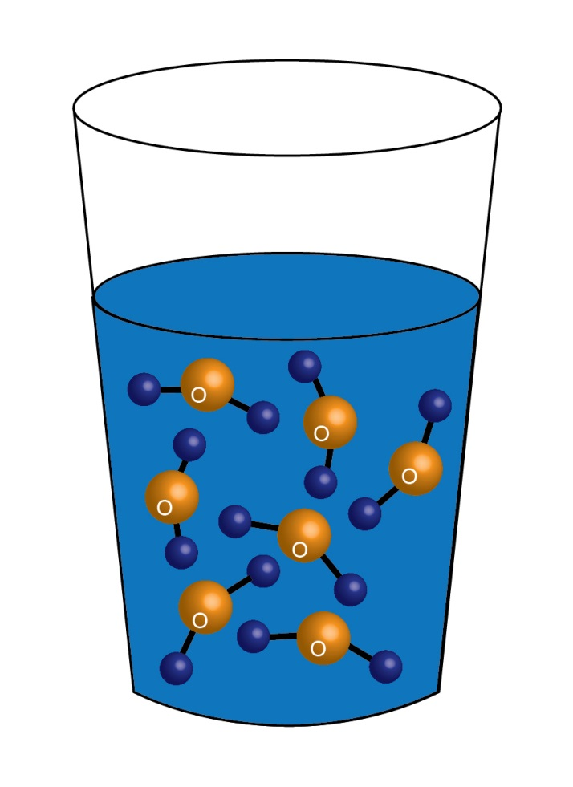
Maintaining Ratios
Fact: Water is H₂O
Fact: Lots of water is lots of “H₂O”s
Fact: H₁₀O₅ has the same ratio
Fact: H₁₀O₅ is not water
Fact 5H₂O is lots of water

Slide 5
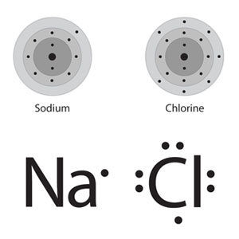
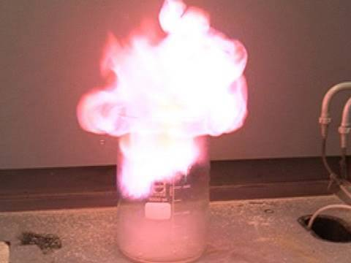
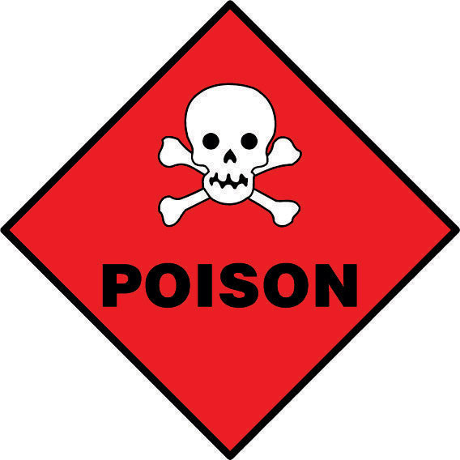
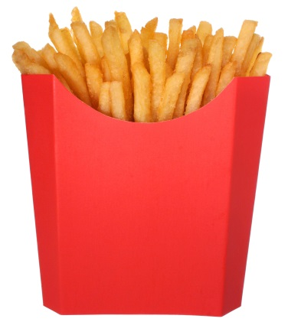
Yummy Poisonous Explosive French Fries
Sodium Chloride
Elements do not maintain their original chemical characteristics when combined to create a compound.

Slide 6
Change
Physical
Chemical
Break or Cut
Does not change the substance
Does not break bonds
Creates a new substance
Breaks Chemical Bonds
Heat, Acids

Slide 7
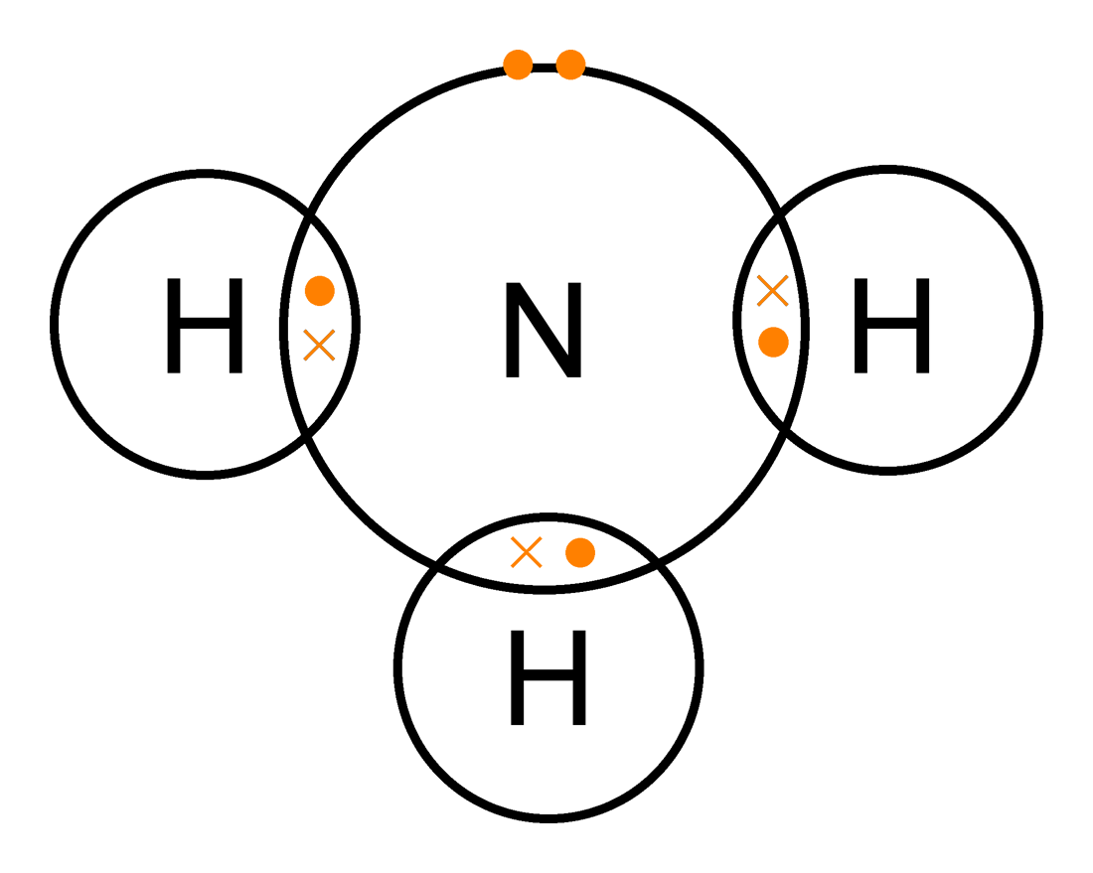
Nitrogen
5 valence electrons
Hydrogen
1 valence electrons
The single Hydrogen electrons bond to the 3 single
Nitrogen electrons.
Don’t forget to record the Protons and Neutrons in the nucleus…

